Slide 1

Python
Dr. Panem Charanarur

Slide 2
Overview
History
Installing & Running Python

Slide 3
Brief History of Python
Invented in the Netherlands, early 90s by Guido van Rossum
Named after Monty Python
Open sourced from the beginning
Considered a scripting language, but is much more
Scalable, object oriented and functional from the beginning
Used by Google from the beginning
Increasingly popular

Slide 4

Python’s Benevolent Dictator For Life
“Python is an experiment in how much freedom program-mers need. Too much freedom and nobody can read another's code; too little and expressive-ness is endangered.”
- Guido van Rossum

Slide 5
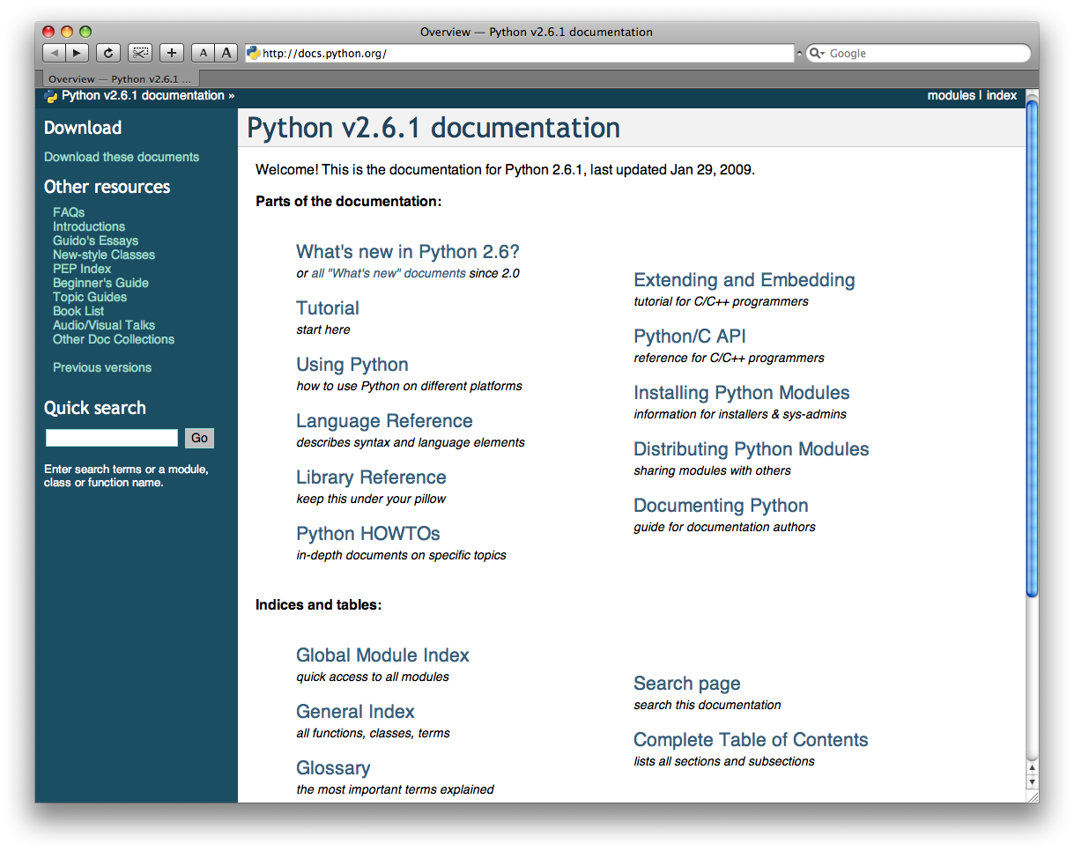
http://docs.python.org/

Slide 6
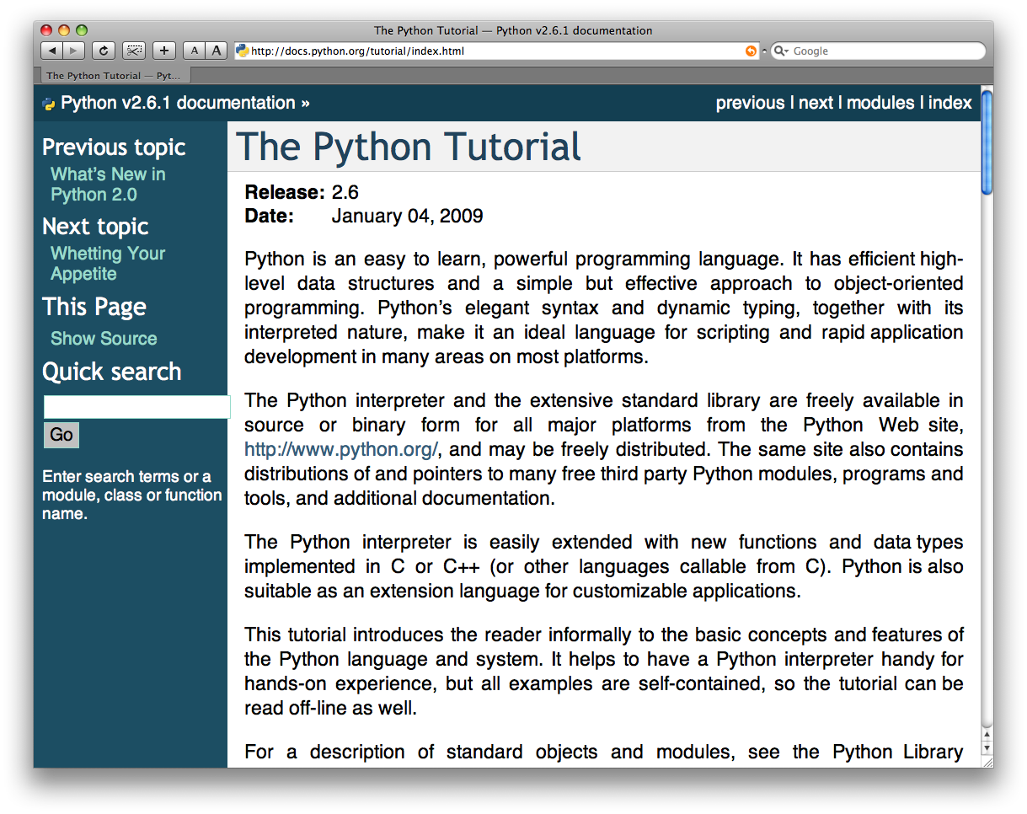
The Python tutorial is good!

Slide 7
Warmup
Windows:
Open anaconda prompt
Type conda –V
If you get an error, install Anaconda: https://docs.anaconda.com/anaconda/install/windows/
  #8 is important: DO NOT add to your path
If no error, consider upgrading conda:
conda update conda
Clone https://github.com/Harvard-IACS/2019-CS109B
(or pull the latest if you’ve already cloned)
Mac:
Open a terminal
Type conda –V
If you get an error, install Anaconda:
https://docs.anaconda.com/anaconda/install/mac-os/
If no error, consider upgrading conda:
  conda update conda
Clone https://github.com/Harvard-IACS/2019-CS109B
(or pull the latest if you’ve already cloned)

Slide 8

Goals
Set up the tools you’ll need for CS109b
  In a way that won’t mess up your other classes
Teach a workflow that will keep your installs tidy
User-level understanding of why ‘environments’ are helpful
Stretch: Ability to produce conda environments for future projects

Slide 9
Basic Python Commands
1. Comments: # symbol is being used for comments in python. For multiline comments, you have to use “”” symbols or enclosing the comment in the “”” symbol.
Example:
print “Hello World” # this is the comment section.
Example:
“”” This is Hello world project.”””
2. Type function: These Python Commands are used to check the type of variable and used inbuilt functions to check.
Example:
type (20), its type is int.
>>> type (20) < type ‘int’ >
Example:
type (-1 +j), its type is complex
>>> type (-1+j)
< type ‘complex’ >
3. Strings: It is mainly enclosed in double-quotes.
Example:
type (“hello World”), type is string
>>> type (“hello World”)
< type ‘str’ >

Slide 10
4. Lists: Lists are mainly enclosed in square bracket. [ ]
Example:
type ( [ 1, 2 ] ), type is list
>>> type ( [ 1, 2, 3 ] )
< type ‘List’ >
5.Tuple: Tuple are mainly enclosed in parenthesis. ( )
Example:
type ( 1, 2, 3), a type is a tuple.
>>> type ( ( 1, 2, 3) )
<type ‘tuple’ >
6. Range: This function is used to create the list of integers. Range(10)
Example:
>>> range ( 10 )
Output: [0, 1, 2, 3, 4, 5, 6, 7, 8, 9]
Example: range(1,10)
>>> range (1,10)
Output: [1, 2, 3, 4, 5, 6, 7, 8, 9]
7. Boolean values: This data type helps in retrieving the data in True or false form.
Example:
>>> True
True
>>> type (True)
< type ‘bool’ >
Example:
>>> False
False
>>> type (False)
< type ‘bool’ >

Slide 11
8. Operator: Different operator is used for the different functions like division, multiply, addition and subtraction.
Example:
>>> 16/2 16/2=8
8
Example:
>>> 2 * * ½ 2 **, -, +
1
9. Variable and assignment: The assignment statement has variable = expression. Single ‘=’ is used for assignment, and double ‘= =’ is used to test for quality.
Example:
>>> X= 235
>>> print X
235
>>> Z= 2* X
>>> print Z
470
10. Comparison operators: To compare the two values and the result of the comparison is always boolean value.
Example:
>>> 2 < 3
True

Slide 12
11. Conditional/ decisions: It is used to make out the decision between two or more values like if-else
Example:
if x=0:
Print “Hello, world.”
Else:
Print “Hello, world in Else.”
12. For Loop: This Python command is used when iteration and action consist of the same elements.
Example:
for x in [ 1, 2, 3, 4, 5, 6]:
Print x;
13. While loop: While loop will never be executed if the condition evaluates to false for the first time.
Example:
x =0
while x<10:
Print x,
X= x+2
14. Else in loop: Loop have optional else for execution.
Example:
for x in [ 1, 3, 5, 7, 9, 11]:
Print x
Else:
Print “In Else”

Slide 13
15. Break, continue statement: break statement is used to exit out the loop when particular output is achieved; continue is used to continue with the next iteration of a loop.
Example:
if x==0:
Print “X is 0”
Break
Else:
Print “X is greater than 0.”
16. Lists: It is the finite number of items, and by assigning a value to list the list value will get changed.
Example:
>>> a = [1, “JAY”, 34] >>> a [0] 1
>>> a [0] = 101
>>> a
[101, “JAY”, 34]
17. Length of list: To know the length if list.
Example:
>>> X = [1, 4, 67,9] >>> len (X)
4
18. Sublists: It will give you the values between the mentioned start index and the end index.
Example:
x [start : end] >>> X [1, 3, 4,6, 7, 8, 9, 0, 2] >>> X [2:5] [4, 6, 7]
19. Joining two list: + operator is being used to concatenate 2 lists.
Example:
>>> [2, 1, 5] + [0, 4,6,7] [2, 1, 5, 0, 4, 6,7]

Slide 14
20. Strings: It is used to check the index to know the character written in string.
Example:
>>> x= “hello, world” “”
>>> x [2] ‘l’
>>> x [5] ‘o’
21. List methods: The different methods available to in list to perform the function.
Example:
X [1, 2,3,4,5]
>>> X.append (7)
>>> x
[1, 2, 3, 4, 5, 7]
>>>X.insert (0, 0)
>>> x
[0, 1, 2, 3, 4, 5]
>>> X.remove (2)
>>> x
[0, 1, 3, 4, 5]
>>> X.pop (1)
>>> x
[2,3,4,5]

Slide 15
Python Conditions and If statements:
Python supports the usual logical conditions from mathematics:
Equals: a == b
Not Equals: a != b
Less than: a < b
Less than or equal to: a <= b
Greater than: a > b
Greater than or equal to: a >= b
These conditions can be used in several ways, most commonly in "if statements" and loops.
An "if statement" is written by using the if keyword.

Slide 16
Example If statement:
a = 33
b = 200
if b > a:
print("b is greater than a")
Elif: The elif keyword is pythons way of saying "if the previous conditions were not true, then try this condition".
Example
a = 33
b = 33
if b > a:
print("b is greater than a")
elif a == b:
print("a and b are equal")

Slide 17
Else:The else keyword catches anything which isn't caught by the preceding conditions.
Example
a = 200
b = 33
if b > a:
print("b is greater than a")
elif a == b:
print("a and b are equal")
else:
print("a is greater than b")
And:The and keyword is a logical operator, and is used to combine conditional statements
Example:Test if a is greater than b, AND if c is greater than a:
a = 200
b = 33
c = 500
if a > b and c > a:
print("Both conditions are True")

Slide 18
Python For Loops:A for loop is used for iterating over a sequence (that is either a list, a tuple, a dictionary, a set, or a string).
This is less like the for keyword in other programming languages, and works more like an iterator method as found in other object-orientated programming languages.
Example
Print each fruit in a fruit list:
fruits = ["apple", "banana", "cherry"]
for x in fruits:
print(x)
The break Statement:With the break statement we can stop the loop before it has looped through all the items:
Example
Exit the loop when x is "banana":
fruits = ["apple", "banana", "cherry"]
for x in fruits:
print(x)
if x == "banana":
break

Slide 19
The continue Statement:With the continue statement we can stop the current iteration of the loop, and continue with the next
Example
Do not print banana:
fruits = ["apple", "banana", "cherry"]
for x in fruits:
if x == "banana":
continue
print(x)
The range() Function:To loop through a set of code a specified number of times, we can use the range() function,
The range() function returns a sequence of numbers, starting from 0 by default, and increments by 1 (by default), and ends at a specified number.
Example
Using the range() function:
for x in range(6):
print(x)

Slide 20
Python Lists:Lists are used to store multiple items in a single variable.
Lists are one of 4 built-in data types in Python used to store collections of data, the other 3 are Tuple, Set, and Dictionary, all with different qualities and usage.
Lists are created using square brackets:
Example
Create a List:
thislist = ["apple", "banana", "cherry"]
print(thislist)
List Length:To determine how many items a list has, use the len() function:
Example
Print the number of items in the list:
thislist = ["apple", "banana", "cherry"]
print(len(thislist))
List Items - Data Types:List items can be of any data type:
Example:String, int and boolean data types:
list1 = ["apple", "banana", "cherry"]
list2 = [1, 5, 7, 9, 3]
list3 = [True, False, False]

Slide 21
Dictionary: Dictionaries are used to store data values in key:value pairs.
A dictionary is a collection which is ordered*, changeable and do not allow duplicates.
Dictionaries are written with curly brackets, and have keys and values
Example
Create and print a dictionary:
thisdict = {
"brand": "Ford",
"model": "Mustang",
"year": 1964
}
print(thisdict)
Dictionary Length:To determine how many items a dictionary has, use the len() function:
Example
print(len(thisdict))
Dictionary Items - Data Types
ExampleString, int, boolean, and list data types:
thisdict = {
"brand": "Ford",
"electric": False,
"year": 1964,
"colors": ["red", "white", "blue"]
}

Slide 22
Network: The standard library of Python has full support for network protocols, encoding, and decoding of data and other networking concepts, and it is simpler to write network programs in Python
There are two levels of network service access in Python. These are:
Low-Level Access
High-Level Access
In the first case, programmers can use and access the basic socket support for the operating system using Python's libraries, and programmers can implement both connection-less and connection-oriented protocols for programming.
Sockets use protocols for determining the connection type for port-to-port communication between client and server machines. The protocols are used for:
Domain Name Servers (DNS)
IP addressing
E-mail
FTP (File Transfer Protocol) etc.

Slide 23
Python has a socket method that let programmers' set-up different types of socket virtually. The syntax for the socket method is:
Syntax:
g = socket.socket (socket_family, type_of_socket, protocol=value)
For example, if we want to establish a TCP socket, we can write the following code snippet:
Example:
# imports everything from 'socket'
from socket import *
# use socket.socket() - function
tcp1=socket.socket(socket.AF_INET, socket.SOCK_STREAM)
you defined the socket, you can use several methods to manage the connections. Some
of the important server socket methods are:
listen(): is used to establish and start TCP listener.
bind(): is used to bind-address (host-name, port number) to the socket.
accept(): is used to TCP client connection until the connection arrives.
connect(): is used to initiate TCP server connection.
send(): is used to send TCP messages.
recv(): is used to receive TCP messages.
sendto(): is used to send UDP messages
close(): is used to close a socket.

Slide 24
Selection:
Python’s select() function is a direct interface to the underlying operating system implementation.
It monitors sockets, open files, and pipes (anything with a fileno() method that returns a valid file descriptor) until they become readable or writable, or a communication error occurs. select() makes it easier to monitor multiple connections at the same time, and is more efficient than writing a polling loop in Python using socket timeouts, because the monitoring happens in the operating system network layer, instead of the interpreter.
Note:Using Python’s file objects with select() works for Unix, but is not supported under Windows.
Example:
import select
import socket
import sys
import Queue
# Create a TCP/IP socket
server = socket.socket(socket.AF_INET, socket.SOCK_STREAM)
server.setblocking(0)
# Bind the socket to the port
server_address = ('localhost', 10000)
print >>sys.stderr, 'starting up on %s port %s' %
server_address server.bind(server_address)
# Listen for incoming connections
server.listen(5)

Slide 25
Functions: In Python, a defined function's declaration begins with the keyword def and followed by the function name.
The function may take arguments(s) as input within the opening and closing parentheses, just after the function name followed by a colon.
After defining the function name and arguments(s) a block of program statement(s) start at the next line and these statement(s) must be indented.
Here is the syntax of a user defined function.
Syntax:
def function_name(argument1, argument2, ...) :
statement_1 statement_2 ....
Example:
def nsquare(x, y):
return (x*x + 2*x*y + y*y)
print("The square of the sum of 2 and 3 is : ", nsquare(2, 3))

Slide 26
Python Iterators:An iterator is an object that contains a countable number of values.
An iterator is an object that can be iterated upon, meaning that you can traverse through all the values.
Technically, in Python, an iterator is an object which implements the iterator protocol, which consist of the methods __iter__() and __next__()
Example: Create an iterator that returns numbers, starting with 1, and each sequence will increase by one (returning 1,2,3,4,5 etc.):
class MyNumbers:
def __iter__(self):
self.a = 1
return self
def __next__(self):
x = self.a
self.a += 1
return x
myclass = MyNumbers()
myiter = iter(myclass)
print(next(myiter))
print(next(myiter))
print(next(myiter))
print(next(myiter))
print(next(myiter))
Example:Stop after 20 iterations:
class MyNumbers:
def __iter__(self):
self.a = 1
return self
def __next__(self):
if self.a <= 20:
x = self.a
self.a += 1
return x
else:
raise StopIteration
myclass = MyNumbers()
myiter = iter(myclass)
for x in myiter:
print(x)

Slide 27
Python Classes:
To create a class, use the keyword class.
Example1:Create a class named MyClass, with a property named x:
class MyClass:
x = 5
Example 2:Create a class named Person, use the __init__() function to assign values for name and age:
class Person:
def __init__(self, name, age):
self.name = name
self.age = age
p1 = Person("John", 36)
print(p1.name)
print(p1.age)
Python Objects:
Example1:Create an object named p1, and print the value of x:
p1 = MyClass()
print(p1.x)
Example 2:Insert a function that prints a greeting, and execute it on the p1 object:
class Person:
def __init__(self, name, age):
self.name = name
self.age = age
def myfunc(self):
print("Hello my name is " + self.name)
p1 = Person("John", 36)
p1.myfunc()

Slide 28
Python Inheritance
Inheritance allows us to define a class that inherits all the methods and properties from another class.
Parent class is the class being inherited from, also called base class.
Child class is the class that inherits from another class, also called derived class.
Create a Parent Class
Any class can be a parent class, so the syntax is the same as creating any other class:
Example
Create a class named Person, with firstname and lastname properties, and a printname method:
class Person:
def __init__(self, fname, lname):
self.firstname = fname
self.lastname = lname
def printname(self):
print(self.firstname, self.lastname)
#Use the Person class to create an object, and then execute the printname method:
x = Person("John", "Doe")
x.printname()
Composition (Has-A Relation)
Here, by using the class name or by creating the object we can access the members of one class inside another class. It enables creating complex types by combining objects of different classes. It means that a class Composite can contain an object of another class Component. This type of relationship is known as Has-A Relation.
Example:
class Component:
# composite class constructor
def __init__(self):
print('Component class object created...')
# composite class instance method
def m1(self):
print('Component class m1() method executed...')
class Composite:
# composite class constructor
def __init__(self):
# creating object of component class
self.obj1 = Component()
print('Composite class object also created...')
# composite class instance method
def m2(self):
print('Composite class m2() method executed...')
# calling m1() method of component class
self.obj1.m1()
# creating object of composite class
obj2 = Composite()
# calling m2() method of composite class
obj2.m2()

Slide 29
Python Comments
Comments can be used to explain Python code.
Comments can be used to make the code more readable.
Comments can be used to prevent execution when testing code.
Creating a Comment
Comments starts with a #, and Python will ignore them:
Example
#This is a comment
print("Hello, World!")
Python Numbers
There are three numeric types in Python:
int
float
complex
Variables of numeric types are created when you assign a value to them:
Example
x = 1 # int
y = 2.8 # float
z = 1j # complex
print(type(x))
print(type(y))
print(type(z))

Slide 30
Python Math
Python has a set of built-in math functions, including an extensive math module, that allows you to perform mathematical tasks on numbers.
Built-in Math Functions
The min() and max() functions can be used to find the lowest or highest value in an iterable:
Example
x = min(5, 10, 25)
y = max(5, 10, 25)
print(x)
print(y)
Variable Names
A variable can have a short name (like x and y) or a more descriptive name (age, carname, total_volume).
Rules for Python variables:
A variable name must start with a letter or the underscore character.
A variable name cannot start with a number.
A variable name can only contain alpha-numeric characters and underscores (A-z, 0-9, and _ ).
Variable names are case-sensitive (age, Age and AGE are three different variables)
Example
#Legal variable names:
myvar = "John"
my_var = "John"
_my_var = "John"
myVar = "John"
MYVAR = "John"
myvar2 = "John"
#Illegal variable names:
2myvar = "John"
my-var = "John"
my var = "John"

Slide 31
Introduction of Anaconda:
Anaconda is a data science platform for data scientists, IT professionals, and business leaders. It is a distribution of Python, R, etc. With more than 300 packages for data science, it quickly became one of the best platforms for any project
https://docs.anaconda.com/anaconda/install/windows/

Slide 32
Unit-IV
Python and Scripting Part-II

Slide 33
File Handling
Python also support file handling like other languages which include different file operations like opening a file, reading, writing and closing the file but before going into depth first we need to understand why we do file handling what is the need of file handling.
File Operations
Opening a File
python has inbuild function to open a file. This function returns a file object, also called handle. we call it handle as it is used to read or modify a file accordingly.
f=open('file_name.txt')
Read and Write (perform operations)
Python File Mode
'r' open file for read (default)
'w' write , it create a new file if it does not exist or truncate the file if it exists.‘
x' open a file for exclusive creation but if file already exists then the operation will fail.
'a' open for appending at the end of file without truncating it and if no file exist already then it create a new one.
't' open file in text mode(default)'b' open file in binary mode. we can use binary mode for storing matrix or list of data.
'+' open a file for updating (reading and writing)

Slide 34
Close file
closing a file is done by mostly using close() method. python has a garbage collector to clean up an referenced object but, we must not rely on it to close the file.
f=open('file_name.txt')
f.close()

Slide 35
Python - sys Module
The sys module provides functions and variables used to manipulate different parts of the Python runtime environment. You will learn some of the important features of this module here.
sys.argv
sys.argv returns a list of command line arguments passed to a Python script. The item at index 0 in this list is always the name of the script. The rest of the arguments are stored at the subsequent indices.
import sys
print("You entered: ",sys.argv[1], sys.argv[2], sys.argv[3])
sys.exit
This causes the script to exit back to either the Python console or the command prompt. This is generally used to safely exit from the program in case of generation of an exception.
sys.maxsize
Returns the largest integer a variable can take.
import sys
sys.maxsize
sys.path
This is an environment variable that is a search path for all Python modules.
import sys
sys.path
sys.version
This attribute displays a string containing the version number of the current Python interpreter.
import sys
sys.version

Slide 36
Python - OS Module
It is possible to automatically perform many operating system tasks. The OS module in Python provides functions for creating and removing a directory (folder), fetching its contents, changing and identifying the current directory, etc.
You first need to import the os module to interact with the underlying operating system. So, import it using the import os statement before using its functions.
Getting Current Working Directory
The getcwd() function confirms returns the current working directory.
Example: Get Current Working Directory
import os
os.getcwd()

Slide 37
Creating a Directory
We can create a new directory using the os.mkdir() function, as shown below.
Example: Create a Physical Directory
import os
os.mkdir("C:\MyPythonProject")
Changing the Current Working Directory
We must first change the current working directory to a newly created one before doing any operations in it. This is done using the chdir() function. The following change current working directory to C:\MyPythonProject.
Example: Change Working Directory
import os
os.chdir("C:\MyPythonProject") # changing current working directory
os.getcwd()

Slide 38
Removing a Directory
The rmdir() function in the OS module removes the specified directory either with an absolute or relative path. Note that, for a directory to be removed, it should be empty.
Example: Remove Directory
import os
os.rmdir("C:\\MyPythonProject")
List Files
The listdir() function returns the list of all files and directories in the specified directory.
Example: List Directories
import os
os.listdir("c:\python37")

Slide 39
Geolocation Acquisition in Python?
we will discuss on how to get Geolocation when you enter any location name and its gives all the useful information such as postal code, city, state, country etc. with the latitudes and the longitudes (the specific coordinates) and vice-versa in which we provide the coordinates to get the location name.
This can be done using the GeoPy library in python. This library isn’t built into python and hence needs to be installed explicitly.
Method 1: Getting coordinates from location name
With provided location, it is possible using geopy to extract the coordinates meaning its latitude and longitude. Therefore, it can be used to express the location in terms of coordinates.
Approach
Import module
Import Nominatim from geopy- Nominatim is a free service or tool or can be called an API with no keys that provide you with the data after providing it with name and address and vice versa.
On calling the Nomination tool which accepts an argument of user_agent you can give any name as it considers it to be the name of the app to which it is providing its services.
The geocode() function accepts the location name and returns a geodataframe that has all the details and since it’s a dataframe we can get the address, latitude and longitude by simply calling it with the given syntax
Syntax:
variablename.address
variablename.latitude
variablename.longitude.

Slide 40
# importing geopy library
from geopy.geocoders import Nominatim
# calling the Nominatim tool
loc = Nominatim(user_agent="GetLoc")
# entering the location name
getLoc = loc.geocode("Gosainganj Lucknow")
# printing address
print(getLoc.address)
# printing latitude and longitude
print("Latitude = ", getLoc.latitude, "\n")
print("Longitude = ", getLoc.longitude)

Slide 41
Method 2: Getting location name from latitude and longitude
In this method all the things are same as the above, the only difference is instead of using the geocode function we will now use the reverse() method which accepts the coordinates (latitude and longitude) as the argument, this method gives the address after providing it with the coordinates.
Syntax:
reverse(latitude,longitude)
Approach
Import module
Call nominatim tool
Pass latitude and longitude to reverse()
Print location name

Slide 42
# importing modules
from geopy.geocoders import Nominatim
# calling the nominatim tool
geoLoc = Nominatim(user_agent="GetLoc")
# passing the coordinates
locname = geoLoc.reverse("26.7674446, 81.109758")
# printing the address/location name
print(locname.address)

Slide 43
What Are Whitelists and Blacklists?
As an example of how whitelists and blacklists work, let’s consider a system administrator working for Google. Google is the most popular website globally — nearly everyone on the internet uses Google — but with its popularity comes nefarious users who may try to attack it, bring down its servers, or compromise user data. A system administrator will need to blacklist IP addresses acting nefariously while allowing all other valid incoming traffic.
Now, let’s suppose that this same system administrator needs to configure a development server for Google’s own internal use and testing. This system admin will need to block all incoming IP addresses except for the whitelisted IP addresses of Google’s developers.
The concept of whitelisting and blacklisting characters for OCR purposes is the same. A whitelist specifies a list of characters that the OCR engine is only allowed to recognize — if a character is not on the whitelist, it cannot be included in the output OCR results.
The opposite of a whitelist is a blacklist. A blacklist specifies the characters that, under no circumstances, can be included in the output.

Slide 44
Packet Analysis:
With Python code, you can iterate over the packets in a pcap, extract relevant data, and process that data in ways that make sense to you.
You can use code to go over the pcap and locate a specific sequence of packets (i.e. locate the needle in the haystack) for later analysis in a GUI tool like Wireshark.
Or you can create customized graphical plots that can help you visualize the packet information. Further, since this is all code, you can do this repeatedly with multiple pcaps
Note: https://vnetman.github.io/pcap/python/pyshark/scapy/libpcap/2018/10/25/analyzing-packet-captures-with-python-part-1.html

Slide 45
Packet Reassembly:
Network protocols often need to transport large chunks of data which are complete in themselves, e.g. when transferring a file. The underlying protocol might not be able to handle that chunk size (e.g. limitation of the network packet size), or is stream-based like TCP, which doesn’t know data chunks at all.
In that case the network protocol has to handle the chunk boundaries itself and (if required) spread the data over multiple packets. It obviously also needs a mechanism to determine the chunk boundaries on the receiving side.
Wireshark calls this mechanism reassembly, although a specific protocol specification might use a different term for this (e.g. desegmentation, defragmentation, etc).

Slide 46
Payload Extraction:

Slide 47
Forensic Python
Extracting valuable information from the resources available is a vital part of digital forensics.
Getting access to all the information available is essential for an investigation process as it helps in retrieving appropriate evidence.
Resources that contain data can be either simple data structures such as databases or complex data structures such as a JPEG image.
Simple data structures can be easily accessed using simple desktop tools, while extracting information from complex data structures require sophisticated programming tools.

Slide 48
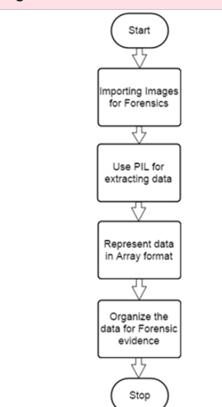
Python Imaging Library
The Python Imaging Library (PIL) adds image processing capabilities to your Python interpreter. This library supports many file formats, and provides powerful image processing and graphics capabilities.
Pillow is a fork of the Python Imaging Library (PIL). PIL is a library that offers several standard procedures for manipulating images. It's a powerful library but hasn't been updated since 2009 and doesn't support Python 3.
Pillow builds on this, adding more features and support for Python 3. It supports a range of image file formats such as PNG, JPEG, PPM, GIF, TIFF, and BMP. We'll see how to perform various operations on images such as cropping, resizing, adding text to images, rotating, greyscaling, etc., using this library.

Slide 49
Example
Now, let’s have a programming example to understand how it actually works.
Step 1 − Suppose we have the following image from where we need to extract information
Step 2 − When we open this image using PIL, it will first note the necessary points required for extracting evidence, which includes various pixel values. Here is the code to open the image and record its pixel values
Step 3 − Our code will produce the following output, after extracting the pixel values of the image.
The output delivered represents the pixel values of RGB combination, which gives a better picture of what data is needed for evidence. The data fetched is represented in the form of an array.

Slide 50
The Image Object
from PIL import Image
image = Image.open('demo_image.jpg')
image.show()
print(im.format)
print(im.mode)
print(im.size)
im.save('new_image.png')
new_image = im.resize((400, 400))
new_image.save('image_400.jpg')
print(im.size)
print(new_image.size)

Slide 51
Python MySQL
Python can be used in database applications.
One of the most popular databases is MySQL.
Why Python with SQL?
For Data Analysts and Data Scientists, Python has many advantages. A huge range of open-source libraries make it an incredibly useful tool for any Data Analyst
Create Connection
Start by creating a connection to the database.
Use the username and password from your MySQL database:
import mysql.connector
mydb = mysql.connector.connect(
host="localhost",
user="yourusername",
password="yourpassword"
)
print(mydb)

Slide 52
Creating a Database
To create a database in MySQL, use the "CREATE DATABASE" statement:
Example
create a database named "mydatabase":
import mysql.connector
mydb = mysql.connector.connect(
host="localhost",
user="yourusername",
password="yourpassword"
)
mycursor = mydb.cursor()
mycursor.execute("CREATE DATABASE mydatabase")

Slide 53
Insert Into Table
To fill a table in MySQL, use the "INSERT INTO" statement.
Example
Insert a record in the "customers" table:
import mysql.connector
mydb = mysql.connector.connect(
host="localhost",
user="yourusername",
password="yourpassword",
database="mydatabase"
)
mycursor = mydb.cursor()
sql = "INSERT INTO customers (name, address) VALUES (%s, %s)"
val = ("John", "Highway 21")
mycursor.execute(sql, val)
mydb.commit()
print(mycursor.rowcount, "record inserted.")
Insert Into Table
To fill a table in MySQL, use the "INSERT INTO" statement.
Example
Insert a record in the "customers" table:
import mysql.connector
mydb = mysql.connector.connect(
host="localhost",
user="yourusername",
password="yourpassword",
database="mydatabase"
)
mycursor = mydb.cursor()
sql = "INSERT INTO customers (name, address) VALUES (%s, %s)"
val = ("John", "Highway 21")
mycursor.execute(sql, val)
mydb.commit()
print(mycursor.rowcount, "record inserted.")

Slide 54
Select With a Filter
When selecting records from a table, you can filter the selection by using the "WHERE" statement:
Example
Select record(s) where the address is "Park Lane 38": result:
import mysql.connector
mydb = mysql.connector.connect(
host="localhost",
user="yourusername",
password="yourpassword",
database="mydatabase"
)
mycursor = mydb.cursor()
sql = "SELECT * FROM customers WHERE address ='Park Lane 38'"
mycursor.execute(sql)
myresult = mycursor.fetchall()
for x in myresult:
print(x)
Delete Record
You can delete records from an existing table by using the "DELETE FROM" statement:
Example
Delete any record where the address is "Mountain 21":
import mysql.connector
mydb = mysql.connector.connect(
host="localhost",
user="yourusername",
password="yourpassword",
database="mydatabase"
)
mycursor = mydb.cursor()
sql = "DELETE FROM customers WHERE address = 'Mountain 21'"
mycursor.execute(sql)
mydb.commit()
print(mycursor.rowcount, "record(s) deleted")

Slide 55
HTTP Communications with Python Built in Libraries
The http or Hyper Text Transfer Protocol works on client server model. Usually the web browser is the client and the computer hosting the website is the server. IN python we use the requests module for creating the http requests.
It is a very powerful module which can handle many aspects of http communication beyond the simple request and response data. It can handle authentication, compression/decompression, chunked requests etc.
# This function are return the json response of url and json data you send the server
def postReq(url, data):
# handle the exceptions
try:
# make a post request with
# the json data
res = requests.post(url, json=data)
# return the response after
# formatting in json.
return json.dumps(res.json(), indent=4)
except Exception as er:
return f"Message : {er}"
# Driver Code
if __name__ == '__main__':
# always run loop to make
# menu driven program
while True:
# handle the exceptions
try:
choice = int(input("1.Get Request\n2.Post Request\n3.Exit\nEnter Choice : "))
# get user choice and perform tasks.
if choice == 1:
# take a url as a input.
url_inp = input("Enter a valid get url : ")
# print the result of the url.
print(getReq(url_inp))
elif choice == 2:
# take a url as a input
url_inp = input("Enter a valid get url : ")
# take a formal data as input in dictionary.
data_inp = {
"name": input("Name : "),
"email": input("Email : "),
"work": input("Work : "),
"age": input("Age : ")
}
# print the result.
print(postReq(url_inp, data_inp))
elif choice == 3:
# if user want to exit.
exit(0)
except Exception as e:
print("Error : ", e)
# api testing using pyton
# request module to work with api's
import requests
# json module to parse and get json
import json
# This function are return the
json response from given url
def getReq(url):
# handle the exceptions
try:
# make a get request using requests
# module and store the result.
res = requests.get(url)
# return the result after
# formatting in json.
return json.dumps(res.json(), indent=4)
except Exception as ee:
return f"Message : {ee}"

Slide 56
1. Grequests
GRequests allows you to use Requests with Gevent to make asynchronous HTTP Requests easily.
Command: pip install grequests
import grequests
urls = [
‘http://www.heroku.com’,
‘http://python-tablib.org’,
‘http://httpbin.org’,
‘http://python-requests.org’,
‘https://yeahhub.com/’
]

Slide 57
2. httplib2 – Comprehensive HTTP client library.
The Hypertext Transfer Protocol (HTTP) is an application protocol for distributed, collaborative, hypermedia information systems. HTTP is the foundation of data communication for the World Wide Web.
Python httplib2 module provides methods for accessing Web resources via HTTP. It supports many features, such as HTTP and HTTPS, authentication, caching, redirects, and compression. Httplib2 is a comprehensive HTTP client library, httplib2.py supports many features left out of other HTTP libraries.
HTTPS support is only available if the socket module was compiled with SSL support.
Command: pip install httplib2
#!/usr/bin/python3
import httplib2
http = httplib2.Http()
content = http.request(“https://www.yeahhub.com”)[1]
print(content.decode())

Slide 58
3. Requests – HTTP Requests for Humans.
Requests allows you to send organic, grass-fed HTTP/1.1 requests, without the need for manual labor. There’s no need to manually add query strings to your URLs, or to form-encode your POST data. Keep-alive and HTTP connection pooling are 100% automatic.
Command: pip install requests
#!/usr/bin/python3
import requests
#GET Request
r = requests.get(‘https://api.github.com/events’)
#POST Request
r = requests.post(‘http://httpbin.org/post’, data = {‘key’:’value’})

Slide 59
4. Treq – Python requests like API built on top of Twisted’s HTTP client
Treq is an HTTP library inspired by requests but written on top of Twisted’s Agents. It provides a simple, higher level API for making HTTP requests when using Twisted.
Command: pip install treq
#!/usr/bin/env python
from twisted.internet.task import react
from _utils import print_response
import treq
def main(reactor, *args):
d = treq.get(‘http://httpbin.org/get’)
d.addCallback(print_response)
return d
react(main, [])

Slide 60
5. Urllib3 – A HTTP library with thread-safe connection pooling, file post support, sanity friendly.
Urllib3 is a powerful, sanity-friendly HTTP client for Python. Much of the Python ecosystem already uses urllib3 and you should too. urllib3 brings many critical features that are missing from the Python standard libraries:
Thread safety.
Connection pooling.
Client-side SSL/TLS verification.
File uploads with multipart encoding.
Helpers for retrying requests and dealing with HTTP redirects.
Support for gzip and deflate encoding.
Proxy support for HTTP and SOCKS.
100% test coverage.
Command: pip install urllib3
# Yeahhub.com
from requests.packages import urllib3
http = urllib3.PoolManager()
r = http.request(‘GET’, ‘https://yeahhub.com’)
print “r.status: “, r.status
print “r.data”, r.data

Slide 61
Web Communications with the Requests Module
What is the Request?
When you want to interact with data via a API, this is called a request. A request is made up of the following components:
Endpoint – The URL that delineates what data you are interacting with. Similar to how a web page URL is tied to a specific page, an endpoint URL is tied to a specific resource within an API.
Method– Specifies how you’re interacting with the resource located at the provided endpoint. REST APIs can provide methods to enable full Create, Read, Update, and Delete (CRUD) functionality. Here are common methods most REST APIs provide:
GET – Retrieve data
PUT – Replace data
POST – Create data
DELETE – Delete data

